Slide 1
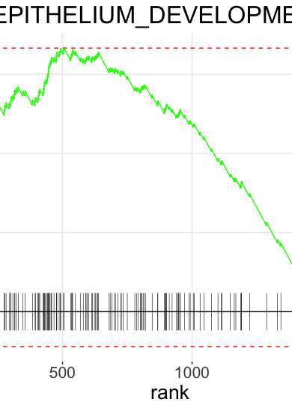
RNA-Seq Analysis
Part 3: Gene Set Enrichment
Eleni Maniati, PhD
Centre for Cancer Genomics and Data Science
Notes:
This title slide should be used directly (with the addition of your presentation title, your name and your centre).
Please do not add any additional logos to this slide.
If you would like to customise the image on the right-hand side of the slide, please use slide 2 which will allow you to add your own image.

Slide 2
Gene Set Analysis
From the Differential Expression analysis we can extract thousands of genes that alter in expression between experimental conditions. To help infer the biological processes and pathways that are affected and gain an insight into biological mechanisms a number of methods have been developed. The two most common approaches are :
Over-representation analysis. This method employs a hypergeometric test to determine whether genes from a predefined set (for example those belonging to the same pathway/biological process) are present more than would be expected by random chance in our gene list of interest (this would be for example the list of significantly upregulated genes in the DESeq2 results, ie genes with an adjusted pvalue < 0.05 and log2 fold-change > 1)
Pre-Ranked Gene Set Enrichment Analysis (GSEA Pre-Ranked). This method was originally developed by Subramanian et al. in 2005 (PMID: 16199517). Unlike the overrepresentation test, it does not require to threshold the differential expression matrix with pvalue thresholds. Instead we provide all genes in the data ranked by a metric of differential expression, this is usually the log2 fold-change or the test-statistic. For each pre-defined gene set the method determines whether there is significant enrichment at either end of the ranking.

Slide 3
Gene-set collections
There is a large number of collections that provide pre-defined gene lists that relate to biological processes and pathways. Below are some of the major collections:
Gene Ontology gene sets
  Biological Processes
  Cellular Compartment
  Molecular Function
Hallmark gene sets
Canonical Pathways
  KEGG
  REACTOME
The MSigDB database provide comprehensive access to all these collections plus many more. We can access it through this link: https://www.gsea-msigdb.org/gsea/msigdb/

Slide 4
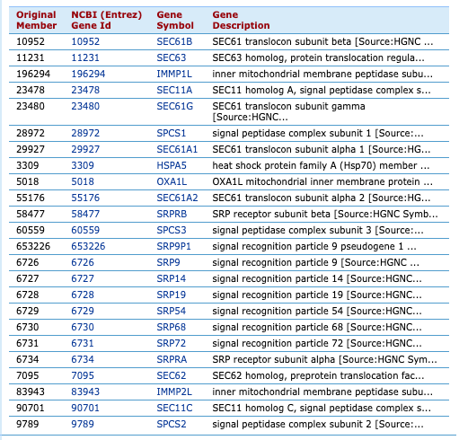
A gene-set example
KEGG_PROTEIN_EXPORT
The protein export is the active transport of proteins from the cytoplasm to the exterior of the cell, or to the periplasmic compartment in Gram-negative bacteria. The sec dependent pathway is the general protein export system that transports newly synthesized proteins into or across the cell membrane. The translocation channel is formed from a conserved trimeric membrane protein complex, called the Sec61/SecY complex. The twin-arginine translocation (Tat) pathway is another protein transport system that transports folded proteins in bacteria, archaea, and chloroplasts. Many Tat systems comprise three functionally different membrane proteins, TatA, TatB, and TatC, but TatA and TatE seem to have overlapping functions, with TatA having by far the more important role.
Contains 24 genes

Slide 5
Implementation of Gene Set Analysis – Online Platforms
Both methods can be implemented using online platforms. Below are commonly used online platforms which you can look up in your own time.
Platforms for over-representation test analysis:
Metascape https://metascape.org/gp/index.html#/main/step1
Panther DB http://www.pantherdb.org/
DAVID https://david.ncifcrf.gov/
Enrichr https://maayanlab.cloud/Enrichr/
Platform for GSEA analysis
GenePattern https://www.genepattern.org/#gsc.tab=0

Slide 6
Implementation of Gene Set Analysis – R packages
Gene set analysis can also be implemented in R through R packages. We are going to use:
clusterProfiler for over-representation analysis
fgsea for pre-ranked gsea

Slide 7
Over-representation test with clusterProfiler

Slide 8
Gene Set Analysis with clusterProfiler
Aim: We are going to examine which biological processes are enriched in the significantly differentially expressed genes that are upregulated in chemotherapy sensitive cells compared to the resistant cells
Let’s start by installing clusterProfiler and it’s associated packages
BiocManager::install("clusterProfiler")
library(clusterProfiler)
install.packages("msigdbr")
library(msigdbr)
#we also need R package dplyr for data wrangling
install.packages("dplyr")
library(dplyr)

Slide 9
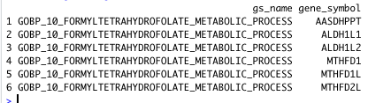
Gene Set Analysis with clusterProfiler – preparing the gene-set collection
Here we are going to load the C5 collection from MSigDB which corresponds to gene ontologies and then select the gene set name and the corresponding gene symbols into a separate dataframe that we are going to use for the over-representation test.
go_gene_sets <- msigdbr(species = "human", category = "C5")
msigdbr_t2g <- go_gene_sets %>% dplyr::distinct(gs_name,gene_symbol) %>% as.data.frame()
head(msigdbr_t2g )

Slide 10

Gene Set Analysis with clusterProfiler – Preparing our gene-list of interest
Here we are going to load DESeq2 results with the differential gene expression and then subset the data to obtain the significantly upregulated genes.
DE.res <- read.csv("/Users/maniat01/Documents/DE_sensitiveVSresistant_results_wGeneSymbol.csv", header = TRUE, row.names = 1)
DE.res.sign <- subset(DE.res, padj < 0.05 & log2FoldChange > 1)
#Let’s check how many they are
nrow(DE.res.sign)

Slide 11
Gene Set Analysis with clusterProfiler – Performing the over-representation test
Now we are going to perform the over-representation test using our gene list of interest (ie the significantly up-regulated genes in sensitive vs resistant cells) and the Gene Ontology collection.
enrichRes <- enricher(gene = DE.res.sign$gene.symbol, TERM2GENE = msigdbr_t2g, pvalueCutoff = 0.05, pAdjustMethod = "BH")
head(enrichRes)
Also, let’s write the output into a file
write.csv(enrichRes, file = "/Users/maniat01/Documents/RNASeq_practical/GO_sensitiveVSresistant_up.csv", row.names = FALSE)

Slide 12
GSEA Pre-Ranked

Slide 13
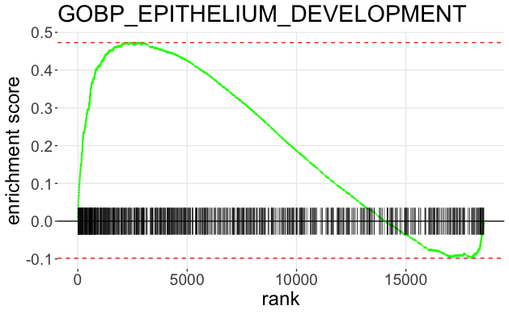
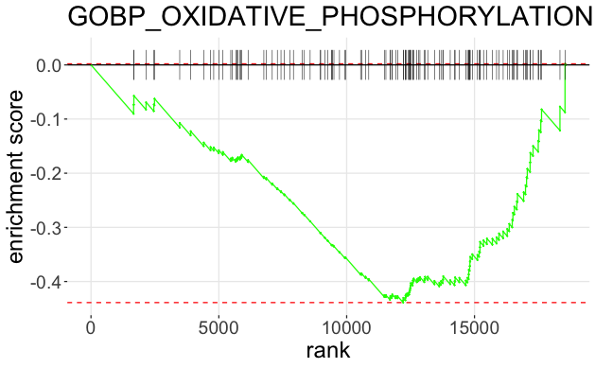
Pre-ranked GSEA with R package fgsea
In Pre-Ranked GSEA we rank the genes in our data by decreasing differential expression metric (log fold-change or test-statistic). The method then looks into whether there is significant enrichment of each gene-set in our collection. We are aiming to get information that when plotted for an example gene-set looks like these.
Example of an upregulated pathway
Example of adownregulated pathway

Slide 14
Pre-ranked GSEA with R package fgsea
Aim: This time we are not going to threshold the DE results but we are going to rank them on the basis of a differential expression metric, the log₂ fold-change (you could also use the test statistic). The we will look into which Gene Ontologies are significantly enriched in the data and in which direction ie are they up or down-regulated in sensitive versus resistant cells.
Let’s start by installing fgsea and the associated packages that we will need
BiocManager::install("fgsea")
library(fgsea)
install.packages("data.table")
library(data.table)
BiocManager::install("qusage")
library(qusage)
install.packages("ggplot2")
library(ggplot2)

Slide 15
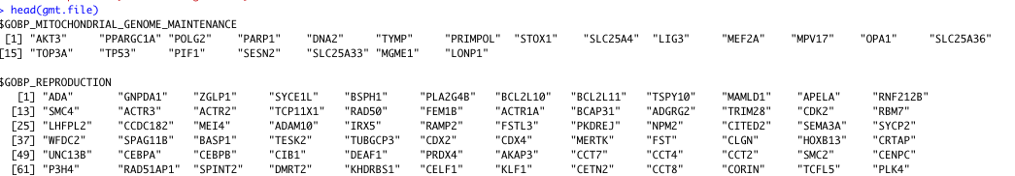
Pre-ranked GSEA with R package fgsea – Loading the Gene Ontology Collection
Firstly, you need to download the gmt file for the collection of your interest from MSigDB, I use the versions of Gene Symbol (https://www.gsea-msigdb.org/gsea/msigdb/human/collections.jsp#H ) and have already downloaded it for you. So, let’s read it in R.
gmt.file <- read.gmt("/Documents/Bix_related_BCI/gsea/c5.go.bp.v7.4.symbols.gmt")

Slide 16
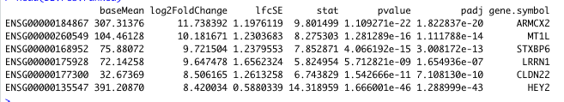

Pre-ranked GSEA with R package fgsea – Ranking our gene list
Now we need to rank our DE results by decresing Log2 Fold-change and then we need to create a named vector of the log2 fold changes with the names being the gene symbols.
DE.res.ranked <- DE.res[order(DE.res$log2FoldChange, decreasing = T), ]
DE.ranks <- setNames(DE.res.ranked$log2FoldChange, DE.res.ranked$gene.symbol)

Slide 17
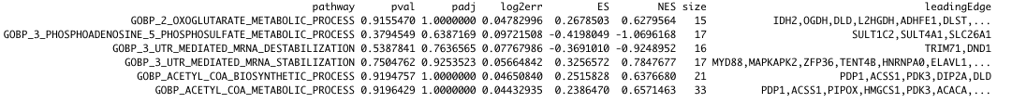
Pre-ranked GSEA with R package fgsea – Running the fgsea function
Here we run fgsea using as input the gmt file and the DE.ranks that we created in the previous two steps.
fgseaRes <- fgsea(gmt.file, DE.ranks, minSize=15, maxSize=500)
head(fgseaRes)
Pathway name
Adjusted p-value
Normalised Enrichment Score (NES)
Also let’s write the results into a file
fwrite(fgseaRes, file = "/Documents/RNASeq_practical/PrerankedGSEA_gobp_sensitiveVSresistant.txt", sep = "\t", sep2=c("", " ", ""))

Slide 18
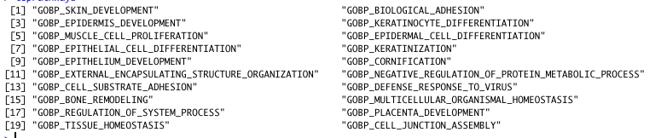
Pre-ranked GSEA with R package fgsea – Enrichment Plot
Finally, lets look into the significantly enriched pathways and make an enrichment plot for one with a positive enrichment score and one with a negative
topPathways <- fgseaRes[order(padj)][padj <= 0.05]$pathway
EnPlot <- plotEnrichment(gmt.file[["GOBP_EPITHELIUM_DEVELOPMENT"]],DE.ranks) + labs(title="GOBP_EPITHELIUM_DEVELOPMENT") + theme(text = element_text(size=20))
EnPlot2 <- plotEnrichment(gmt.file[["GOBP_DEFENSE_RESPONSE_TO_VIRUS"]],DE.ranks) + labs(title="GOBP_DEFENSE_RESPONSE_TO_VIRUS") + theme(text = element_text(size=20))
Plots on next slide

Slide 19
Pre-ranked GSEA with R package fgsea – Enrichment Plot
Here we can see the enrichment plots of one upregulated and one downregulated pathway

Slide 20
Pre-ranked GSEA with R package fgsea – Enrichment Plot
Enrichment score
Leading edge
For more details check:
https://www.gsea-msigdb.org/gsea/doc/GSEAUserGuideFrame.html
Rank at max

Slide 21
References
This is the original version of clusterProfiler
Yu G, Wang L, Han Y, He Q (2012). “clusterProfiler: an R package for comparing biological themes among gene clusters.” OMICS: A Journal of Integrative Biology, 16(5), 284-287. doi: 10.1089/omi.2011.0118.
This is the newest version of clusterprofiler with a lot of visualisations and further functions
Wu T, Hu E, Xu S, Chen M, Guo P, Dai Z, Feng T, Zhou L, Tang W, Zhan L, Fu x, Liu S, Bo X, Yu G (2021). “clusterProfiler 4.0: A universal enrichment tool for interpreting omics data.” The Innovation, 2(3), 100141. doi: 10.1016/j.xinn.2021.100141.
Subramanian et al (2005). Gene set enrichment analysis: A knowledge-based approach for interpreting genome-wide expression profiles. PNAS 102 (43) 15545-15550
Korotkevich G, Sukhov V, Sergushichev A (2019). “Fast gene set enrichment analysis.” bioRxiv. doi: 10.1101/060012, http://biorxiv.org/content/early/2016/06/20/060012.
Further Reading
Pathway enrichment analysis and visualization of omics data using g:Profiler, GSEA, Cytoscape and EnrichmentMap. Nat Protoc. 2019 Feb;14(2):482-517. doi: 10.1038/s41596-018-0103-9.

